Slide 1
TITLE
Kaifa Luo
kaifaluo@foxmail.com
2017/06/18

Slide 2
Review
$$H=\vec{d}\left(\vec{k}\right)·\vec{σ}+\vec{V}·\vec{σ}cosωt\underset{→}{ \hat{U}={\hat{P}}_{+}+{\hat{P}}_{−}e^{iωt} }H_{I}={\hat{U}}^{†}H\hat{U}$$
$${\hat{U}}^{†}\left(\vec{V}·\vec{σ}cosωt\right)\hat{U}={\hat{P}}_{+}\left(\vec{k}\right)\left(V_{0}σ_{z}\right){\hat{P}}_{−}\left(\vec{k}\right)+{\hat{P}}_{+}\left(\vec{k}\right)\left(V_{0}σ_{z}\right){\hat{P}}_{−}\left(\vec{k}\right)=H_{RWA}$$
Key: keep well with time-dependent field term.

Slide 3
Outline
The Rotating Wave Approximation
Example of the RWA——Rabi oscillator
Baker-Campbell-Hausdorf formula
Analytical solution_NP2011
Contrast of two approaches
Type-1 Periodical driven-NLS

Slide 4


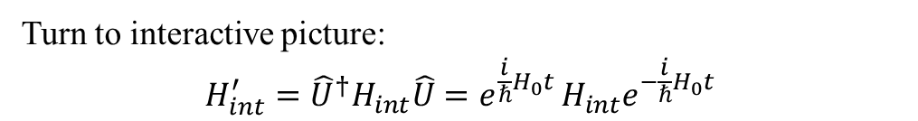
Generic Method of RWA
$$H=H_{0}+H_{int}=d_{z}·σ_{z}+H_{int}$$
Unitary transform: $\hat{U}=e^{−\frac{i}{ℏ}H_{0}t }=e^{(−\frac{i}{ℏ}d_{z}t)·σ_{z}}$
Turn to interactive picture:
$$H_{int}^{′}={\hat{U}}^{†}H_{int}\hat{U}=e^{\frac{i}{ℏ}H_{0}t }H_{int}e^{−\frac{i}{ℏ}H_{0}t }$$
Logic of this method:
(1) Turn from Schrodinger picture to interactive picture;
(2) Omit some high-frequency terms;
(3) Turn back to Schrodinger picture, and the RWA is done.

Slide 5
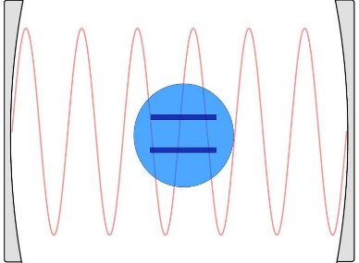
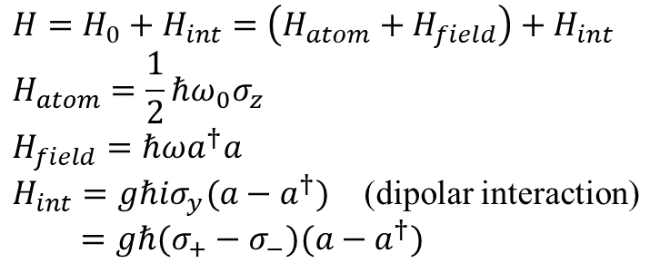
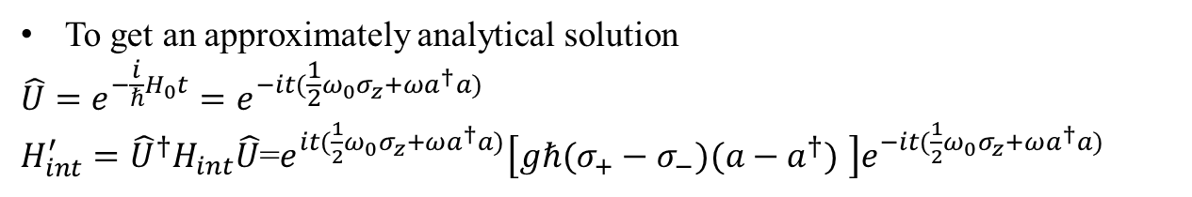
Example of the RWA——Rabi resonator
Background——Cavity quantum electrodynamics(CQED):
the study of the interaction between light confined in a reflective cavity and atoms or other particles, under conditions where the quantum nature of light photons is significant, i.e. , we study a system consist of only one two-level-atom and one photon which interacted with each other.
$$H=H_{0}+H_{int}=\left(H_{atom}+H_{field}\right)+H_{int}$$
$$H_{atom}=\frac{1}{2}ℏω_{0}σ_{z}$$
$$H_{field}=ℏωa^{†}a$$
$H_{int}=gℏ{iσ}_{y}(a−a^{†})$ (dipolar interaction)
$$=gℏ(σ_{+}−σ_{−})(a−a^{†})$$
To get an approximately analytical solution
$$\hat{U}=e^{−\frac{i}{ℏ}H_{0}t}=e^{−it(\frac{1}{2}ω_{0}σ_{z}+ωa^{†}a)}$$
$H_{int}^{′}={\hat{U}}^{†}H_{int}\hat{U}$=$e^{it(\frac{1}{2}ω_{0}σ_{z}+ωa^{†}a)}\left[gℏ(σ_{+}−σ_{−})(a−a^{†}) \right]e^{−it(\frac{1}{2}ω_{0}σ_{z}+ωa^{†}a)}$

Slide 6
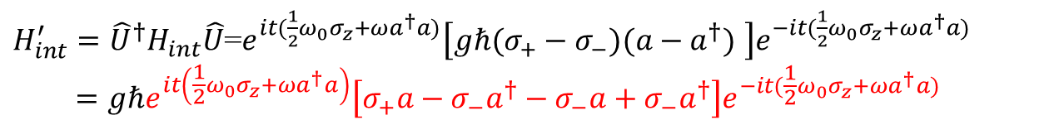
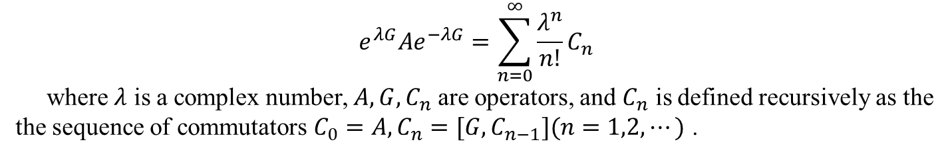
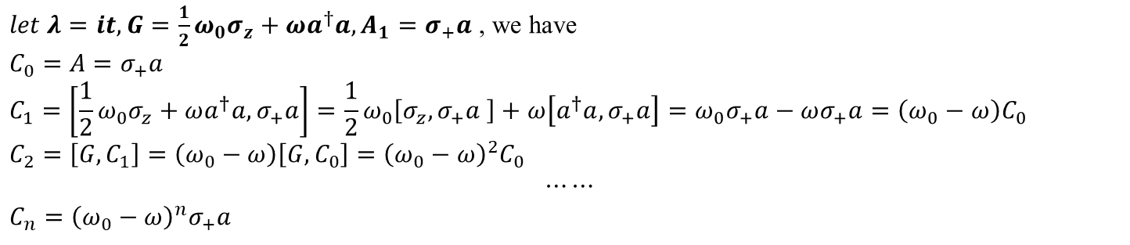
Baker-Campbell-Hausdorf formula
$$e^{λG}Ae^{−λG}=\sum_{n=0}^{∞}{\frac{λ^{n}}{n!}C_{n}}$$
where $λ$ is a complex number, $A,G,C_{n}$ are operators, and $C_{n}$ is defined recursively as the
the sequence of commutators $C_{0}=A, C_{n}=[G,C_{n−1}](n=1,2,⋯)$ .
$H_{int}^{′}={\hat{U}}^{†}H_{int}\hat{U}$=$e^{it(\frac{1}{2}ω_{0}σ_{z}+ωa^{†}a)}\left[gℏ(σ_{+}−σ_{−})(a−a^{†}) \right]e^{−it(\frac{1}{2}ω_{0}σ_{z}+ωa^{†}a)}$
$$=gℏe^{it\left(\frac{1}{2}ω_{0}σ_{z}+ωa^{†}a\right)}\left[σ_{+}a−σ_{−}a^{†}−σ_{−}a+σ_{−}a^{†}\right]e^{−it(\frac{1}{2}ω_{0}σ_{z}+ωa^{†}a)}$$
$let λ=it, G=\frac{1}{2}ω_{0}σ_{z}+ωa^{†}a, A_{1}=σ_{+}a$ , we have
$$C_{0}=A=σ_{+}a$$
$$C_{1}=\left[\frac{1}{2}ω_{0}σ_{z}+ωa^{†}a,σ_{+}a\right]=\frac{1}{2}ω_{0}\left[{σ_{z},σ}_{+}a \right]+ω\left[a^{†}a,σ_{+}a\right]=ω_{0}σ_{+}a−ωσ_{+}a=\left(ω_{0}−ω\right)C_{0}$$
$$C_{2}=\left[G,C_{1}\right]=\left(ω_{0}−ω\right)\left[G, C_{0}\right]={\left(ω_{0}−ω\right)}^{2}C_{0}$$
$$⋯⋯$$
$$C_{n}={\left(ω_{0}−ω\right)}^{n}σ_{+}a$$
$$\sum_{n=0}^{∞}{\frac{λ^{n}}{n!}C_{n}}=\sum_{n=0}^{∞}{\frac{{(it)}^{n}}{n!}{\left(ω_{0}−ω\right)}^{n}σ_{+}a }=σ_{+}a\sum_{n=0}^{∞}{\frac{{[it\left(ω_{0}−ω\right)]}^{n}}{n!}}=e^{i\left(ω_{0}−ω\right)t}σ_{+}a$$

Slide 7
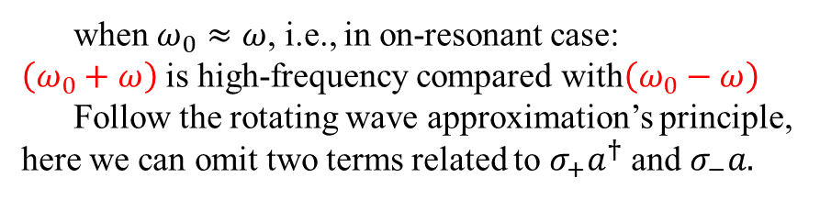
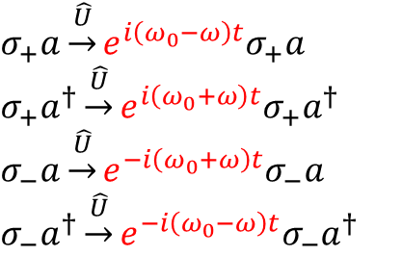
Baker-Campbell-Hausdorf formula
$σ_{+}a\underset{→}{\hat{U}}e^{i\left(ω_{0}−ω\right)t}σ_{+}a$ $σ_{+}a^{†}\underset{→}{\hat{U}}e^{i\left(ω_{0}+ω\right)t}σ_{+}a^{†}$
$$σ_{−}a\underset{→}{\hat{U}}e^{−i\left(ω_{0}+ω\right)t}σ_{−}a$$
$$σ_{−}a^{†}\underset{→}{\hat{U}}e^{−i\left(ω_{0}−ω\right)t}σ_{−}a^{†}$$
when $ω_{0}≈ω$, i.e., in on-resonant case:
$\left(ω_{0}+ω\right)$ is high-frequency compared with$\left(ω_{0}−ω\right)$
Follow the rotating wave approximation’s principle, here we can omit two terms related to $σ_{+}a^{†}$ and $σ_{−}a.$
Turn back to Schrodinger picture, the interactive term of Hamiltonian becomes:
$H_{int}^{′}=gℏ(σ_{+}a+{σ_{−}a}^{†})$ [ before: ${H_{int}=gℏ(σ}_{+}a−σ_{−}a^{†}−σ_{−}a+σ_{−}a^{†})$]
This Hamiltonian, the Jaynes-Cummings Hamiltonian, is very important in the field of quantum optics and optical quantum computer.
$\hat{H}\underset{→}{{\hat{U}}^{†}\hat{H}\hat{U}}$ find the high-frequency terms and omit them$\underset{→}{\hat{U}{\hat{H}}^{′}{\hat{U}}^{†}}{\hat{H}}_{RWA}$

Slide 8
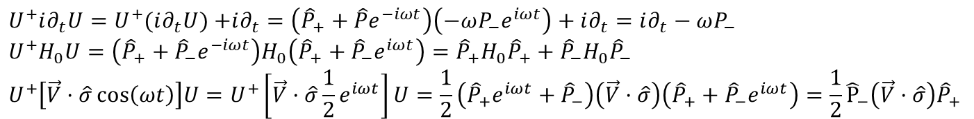

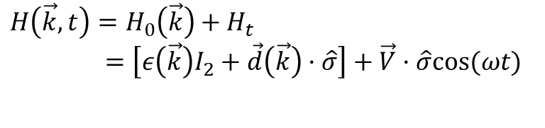




Analytical solution_NP2011
Underlying Hamiltonian:
$$i∂_{t}ψ=H\left(\vec{k},t\right)ψ$$
$$H\left(\vec{k}, t\right)=H_{0}\left(\vec{k}\right)+H_{t}$$
$=\left[ε\left(\vec{k}\right)I_{2}+\vec{d}\left(\vec{k}\right)·\hat{σ}\right]+\vec{V}·\hat{σ}cos⁡(ωt)$
$$Define projectors:{\hat{P}}_{±}=\frac{1}{2}\left(I_{2}±\hat{d}\left(\vec{k}\right)·σ\right)$$
$$\hat{U}={\hat{P}}_{+}+{\hat{P}}_{−}e^{iωt}$$
Diagonization:${ T}^{+}HT=ε\left(\vec{k}\right)I_{2}+\left|\vec{d}\left(\vec{k}\right)\right|σ_{z}$
$$Projectors: T^{+}{\hat{P}}_{±}T=\frac{1}{2}(I_{2}±σ_{z})$$
$$\left(U^{+}i∂_{t}U\right)\left(U^{+}ψ\right)=[U^{+}(H_{0}+H_{t})U](U^{+}ψ)$$
$U^{+}i∂_{t}U=U^{+}(i∂_{t}U)$ $+i∂_{t}=\left({\hat{P}}_{+}+\hat{P}e^{−iωt}\right)\left(−ωP_{−}e^{iωt}\right)+i∂_{t}=i∂_{t}−ωP_{−}$
$$U^{+}H_{0}U=\left({\hat{P}}_{+}+{\hat{P}}_{−}e^{−iωt}\right)H_{0}\left({\hat{P}}_{+}+{\hat{P}}_{−}e^{iωt}\right)={\hat{P}}_{+}H_{0}{\hat{P}}_{+}+{\hat{P}}_{−}H_{0}{\hat{P}}_{−}$$
$$U^{+}\left[\vec{V}·\hat{σ}\cos\left(ωt\right)\right]U=U^{+}\left[\vec{V}·\hat{σ}\frac{1}{2}e^{iωt}\right]U=\frac{1}{2}\left({\hat{P}}_{+}e^{iωt}+{\hat{P}}_{−}\right)\left(\vec{V}·\hat{σ}\right)\left({\hat{P}}_{+}+{\hat{P}}_{−}e^{iωt}\right)=\frac{1}{2}{\hat{P}}_{−}\left(\vec{V}·\hat{σ}\right){\hat{P}}_{+}$$

Slide 9
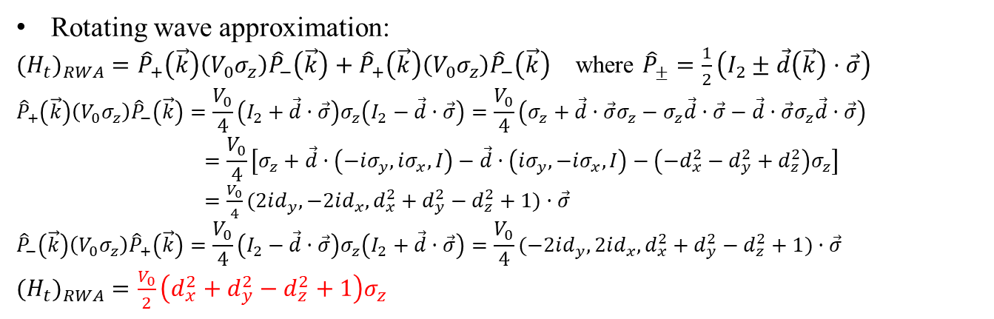
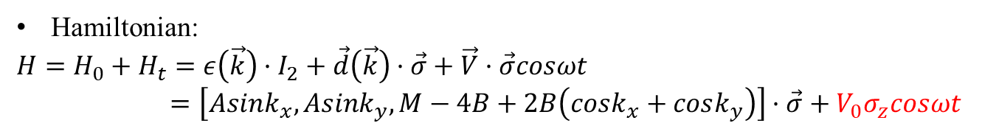
Analytical solution_NP2011
Hamiltonian:
$$H=H_{0}+H_{t}=ε\left(\vec{k}\right)·I_{2}+\vec{d}\left(\vec{k}\right)·\vec{σ}+\vec{V}·\vec{σ}cosωt$$
$$=\left[Asink_{x},Asink_{y},M−4B+2B\left(cosk_{x}+cosk_{y}\right)\right]·\vec{σ}+V_{0}σ_{z}cosωt$$
Rotating wave approximation:
${{(H}_{t})}_{RWA}={\hat{P}}_{+}\left(\vec{k}\right)\left(V_{0}σ_{z}\right){\hat{P}}_{−}\left(\vec{k}\right)+{\hat{P}}_{+}\left(\vec{k}\right)\left(V_{0}σ_{z}\right){\hat{P}}_{−}\left(\vec{k}\right)$ where ${\hat{P}}_{±}=\frac{1}{2}\left(I_{2}±\vec{d}\left(\vec{k}\right)·\vec{σ}\right)$
$${\hat{P}}_{+}\left(\vec{k}\right)\left(V_{0}σ_{z}\right){\hat{P}}_{−}\left(\vec{k}\right)=\frac{V_{0}}{4}\left(I_{2}+\vec{d}·\vec{σ}\right)σ_{z}\left(I_{2}−\vec{d}·\vec{σ}\right)=\frac{V_{0}}{4}\left(σ_{z}+\vec{d}·\vec{σ}σ_{z}−σ_{z}\vec{d}·\vec{σ}−\vec{d}·\vec{σ}σ_{z}\vec{d}·\vec{σ}\right)$$
$$=\frac{V_{0}}{4}\left[σ_{z}+\vec{d}·\left(−iσ_{y},iσ_{x},I\right)−\vec{d}·\left(iσ_{y},−iσ_{x},I\right)−\left(−d_{x}^{2}−d_{y}^{2}+d_{z}^{2}\right)σ_{z}\right]$$
$=\frac{V_{0}}{4}(2id_{y},−2id_{x},d_{x}^{2}+d_{y}^{2}−d_{z}^{2}+1)·\vec{σ}$
$${\hat{P}}_{−}\left(\vec{k}\right)\left(V_{0}σ_{z}\right){\hat{P}}_{+}\left(\vec{k}\right)=\frac{V_{0}}{4}\left(I_{2}−\vec{d}·\vec{σ}\right)σ_{z}\left(I_{2}+\vec{d}·\vec{σ}\right)=\frac{V_{0}}{4}(−2id_{y},2id_{x},d_{x}^{2}+d_{y}^{2}−d_{z}^{2}+1)·\vec{σ}$$
${{(H}_{t})}_{RWA}=\frac{V_{0}}{2}\left(d_{x}^{2}+d_{y}^{2}−d_{z}^{2}+1\right)σ_{z}$
Zero modes:
$H$=$\left[Asink_{x},Asink_{y},M−4B+2B\left(cosk_{x}+cosk_{y}\right)+\frac{V_{0}}{2}\left(d_{x}^{2}+d_{y}^{2}−d_{z}^{2}+1\right)\right]·\vec{σ}=0$

Slide 10
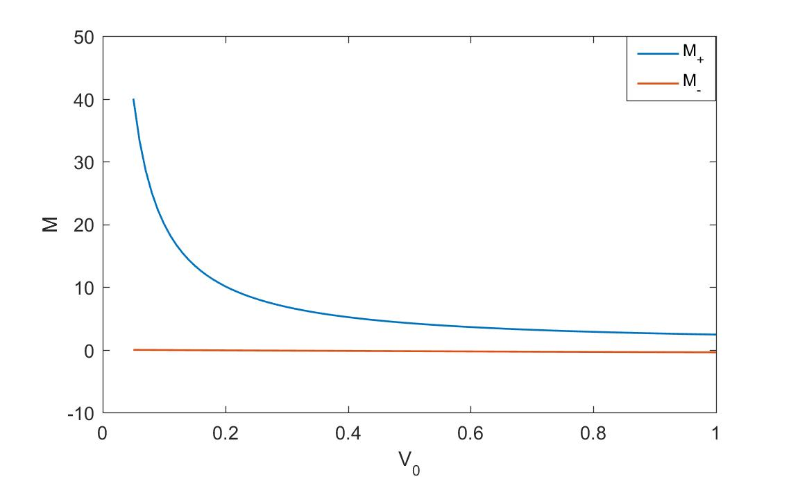
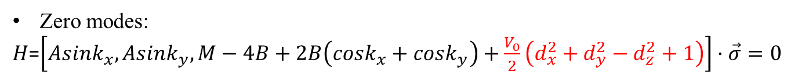

Analytical solution_NP2011
Zero modes:
$H$=$\left[Asink_{x},Asink_{y},M−4B+2B\left(cosk_{x}+cosk_{y}\right)+\frac{V_{0}}{2}\left(d_{x}^{2}+d_{y}^{2}−d_{z}^{2}+1\right)\right]·\vec{σ}=0$
$$d_{x}=d_{y}=0, cosk_{x}=cosk_{y}=1;d_{z}=M−4B+2B\left(cosk_{x}+cosk_{y}\right)=M$$
$$M+\frac{V_{0}}{2}\left(1−M\right)=0→M=\frac{V_{0}}{V_{0}−2}$$
Phase diagram

Slide 11

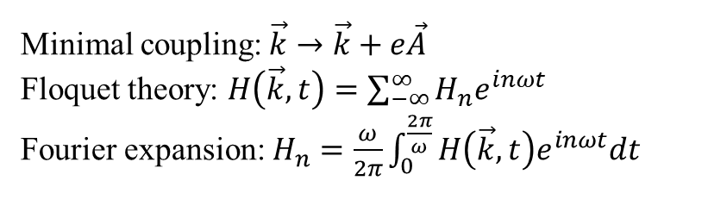
Contrast of two approaches
Off-resonant case:
$$H_{0}\underset{→}{\vec{k}+q\vec{A} }\sum{H_{n}\left(\vec{k}\right)e^{inωt}}→H_{eff}\left(\vec{k}\right)=H_{0}+\sum{\frac{\left[H_{+n},H_{−n}\right]}{nω}}+O\left(\frac{1}{ω^{2}}\right)$$
Minimal coupling:$\vec{k}→\vec{k}+e\vec{A}$
Floquet theory: $H\left(\vec{k},t\right)=\sum_{−∞}^{∞}{H_{n}e^{inωt}}$
Fourier expansion: $H_{n}=\frac{ω}{2π}\int_{0}^{\frac{2π}{ω}}{H\left(\vec{k},t\right)e^{inωt}dt}$
On-resonant case:
$$H=\vec{d}\left(\vec{k}\right)·\vec{σ}+\vec{V}\left(t\right)·\vec{σ}\underset{→}{ \hat{U}={\hat{P}}_{+}+{\hat{P}}_{−}e^{iωt} }H_{I}={\hat{U}}^{†}H\hat{U}$$

Slide 12
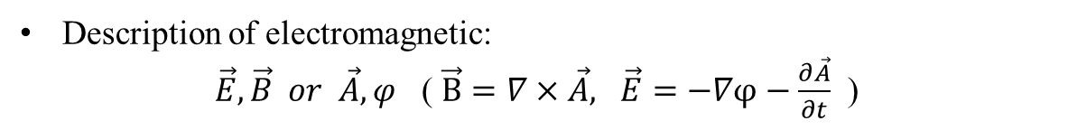
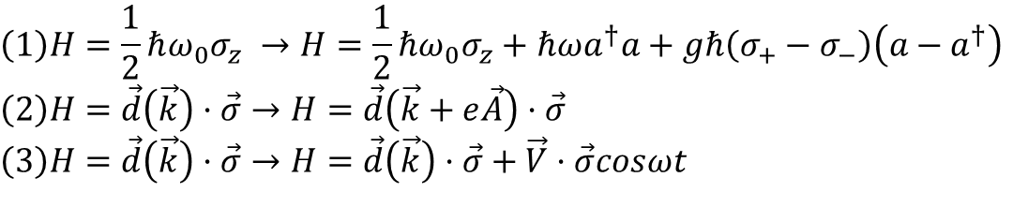
Deal with electromagnetic fields
Description of electromagnetic:
$\vec{E}, \vec{B} or \vec{A}, φ$ ( $\vec{B}=∇×\vec{A}, \vec{E}=−∇φ−\frac{∂\vec{A}}{∂t}$ )
Three ways to deal with electromagnetic as shown in papers
$$\left(1\right)H=\frac{1}{2}ℏω_{0}σ_{z} →H=\frac{1}{2}ℏω_{0}σ_{z}+ℏωa^{†}a+gℏ\left(σ_{+}−σ_{−}\right)\left(a−a^{†}\right)$$
$$\left(2\right)H=\vec{d}\left(\vec{k}\right)·\vec{σ}→H=\vec{d}\left(\vec{k}+e\vec{A}\right)·\vec{σ}$$
$$\left(3\right)H=\vec{d}\left(\vec{k}\right)·\vec{σ}→H=\vec{d}\left(\vec{k}\right)·\vec{σ}+\vec{V}·\vec{σ}cosωt$$
Q1: What is the general means of adding electromagnetic fields to Hamiltonian?
Q2: How to describe CPL/LPL in (3) above?

Slide 13

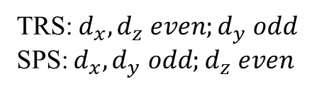

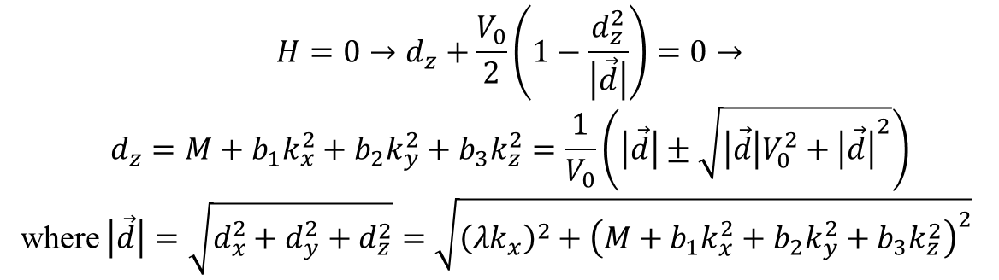
Type 1 Periodical driven-NLS
TRS:${ d}_{x},d_{z} even;d_{y} odd$
SPS:${ d}_{x}, d_{y} odd;d_{z} even$
$$→d_{x}=0, d_{y} odd , d_{z} even$$
$$H=H_{0}+H_{t}=d_{0}I_{2}+\left(λk_{x}\right)σ_{y}+\left(M+b_{1}k_{x}^{2}+b_{2}k_{y}^{2}+b_{3}k_{z}^{2}\right)σ_{z}+V_{0}σ_{z}cosωt$$
${{(H}_{t})}_{RWA}=\frac{V_{0}}{2}\left[{\frac{1}{\left|\vec{d}\right|}(d}_{x}^{2}+d_{y}^{2}−d_{z}^{2})+1\right]σ_{z}=\frac{V_{0}}{2}(1−\frac{d_{z}^{2}}{\left|\vec{d}\right|})σ_{z}$ even!
$$H=H_{0}+{{(H}_{t})}_{RWA}=\left(λk_{x}\right)σ_{y}+\left[M+b_{1}k_{x}^{2}+b_{2}k_{y}^{2}+b_{3}k_{z}^{2}+\frac{V_{0}}{2}\left(1−\frac{d_{z}^{2}}{\left|\vec{d}\right|}\right)\right]σ_{z}$$
$$d_{z}$$
$$H=0→d_{z}+\frac{V_{0}}{2}\left(1−\frac{d_{z}^{2}}{\left|\vec{d}\right|}\right)=0→$$
$$d_{z}=M+b_{1}k_{x}^{2}+b_{2}k_{y}^{2}+b_{3}k_{z}^{2}=\frac{1}{V_{0}}\left(\left|\vec{d}\right|±\sqrt{\left|\vec{d}\right|V_{0}^{2}+{\left|\vec{d}\right|}^{2}}\right)$$
where $\left|\vec{d}\right|=\sqrt{d_{x}^{2}+d_{y}^{2}+d_{z}^{2}}=\sqrt{{\left(λk_{x}\right)}^{2}+{\left(M+b_{1}k_{x}^{2}+b_{2}k_{y}^{2}+b_{3}k_{z}^{2}\right)}^{2}}$
$$M=f_{±}\left(V_{0}\right)−(M+b_{1}k_{x}^{2}+b_{2}k_{y}^{2}+b_{3}k_{z}^{2})$$

Slide 14
Headline
W D Heiss, J. Phys. A: Math. Theor. 45 (2012), The Physics of exceptional points

